Slide 2
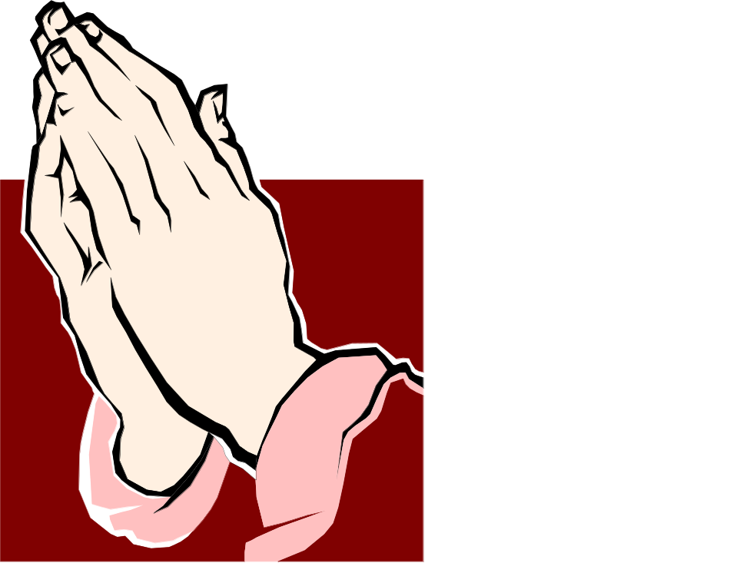
Sermon on the Mount
Matthew 5-7
“Acceptable Prayer”

Slide 3
Sermon
on
the Mount
Matthew 6:5-15
What Prayer Is:
It Is To The God Of All
It Is From His Servants
It Is Offered With Humility, Confidence And According To The Expressed Will Of The Father

Slide 4
Sermon
on
the Mount
Matthew 6:5-15
Acceptable Prayer:
Without Hypocrisy – vs. 5,6
Not a time for our best acting performance
Not a time for vengeance
Worldly motives not to guide our petitions to God
Pharisees Putting Themselves On Display
Matthew 23:14 “for a pretense make long prayers”

Slide 5
Sermon
on
the Mount
Matthew 6:5-15
Without Vain Repetitions vs. 7,8
  “the constant repetition of the same phrase or the mechanical recitation of a long series of obscure or meaningless formulas.”
  1 Corinthians 14:15 “I will pray with the spirit, and I will also pray with the understanding”
Things For Which We Can Pray vs. 9-13
  “Manner” – not repeat over and over
  Address God: Father vs.9
  Kingdom Has Come vs. 10

Slide 6
Sermon
on
the Mount
Matthew 6:5-15
Things For Which We Can Pray vs. 9-13
  God’s Will Over Ours vs. 10
  Food and Such to Sustain Life vs.11
  Forgiveness of Debts vs. 12
  Strength To Deal With Trial vs. 13
  Help to Overcome vs. 13
  Recognition of God’ Greatness & Glory vs. 13
  With Forgiveness in Heart & On Lips vs. 14,15
  Acceptable Prayer involves absence of hate & malice, that vengeful spirit Jesus spoke of in Matthew 5:21-26

Slide 7
Sermon
on
the Mount
Matthew 6:5-15
Many Are Seen In The World Today Praying
  That which separates acceptable from unacceptable prayer is given in our text this evening
  Some exercise “religion” but never reach God
  2 Timothy 3:1-7 “ "having a form of godliness but denying its power”
  We need to REACH and TEACH such people
  We have what they need – THE GOSPEL OF JESUS CHRIST

